Slide 1
Wiki Loves statistics and more with Pywikibot
Miguel-Angel Monjas
mmonjas@gmail.com
MediaLab Prado, Madrid, 2018-02-21

Slide 2
Agenda!
Where everything started: Wiki Loves…
Bots in Wikipedia?
A Python bot framework: Pywikibot. Concepts and how-to.
Nice Python packages to enhance what you do.
MediaWiki API. Another way to query the projects.
Dynamic maps in Wikimedia projects.
Local deployment or cloud-based? PAWS.
Hands on: Wiki Loves Earth statistics
Setting up the environment (PAWS)
Contest log
Writing a nice template
WLE map
WLE use
Wrapping up and creating the actual statistics
Questions, comments, how to contribute?

Slide 3
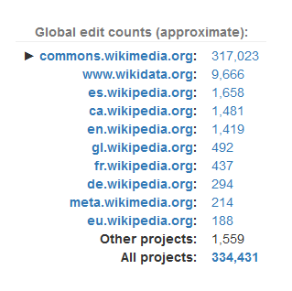




About me
Miguel-Angel Monjas:
Telecom engineer, data scientist, innovation coach…
Proud wiki(p/m)edian since December 2004:
Half a million (492363) editions since then in all the Wikimedia projects
Creator of the Wikiproject Madrid in the Spanish Wikipedia
Generator of the statistics of the Wiki Loves * in Spain contests
Third prize in Wiki Loves Folk 2016
Member of Wikimedia Spain from time to time
@mmonjaspro
https://github.com/miguel-angel-monjas/
http://www.linkedin.com/in/mmonjas
Author’s portrait © 2016-2018 Miguel-Angel Monjas

Slide 4
Where everything started Wiki Loves (Monuments, Earth, Folk…)

Slide 5
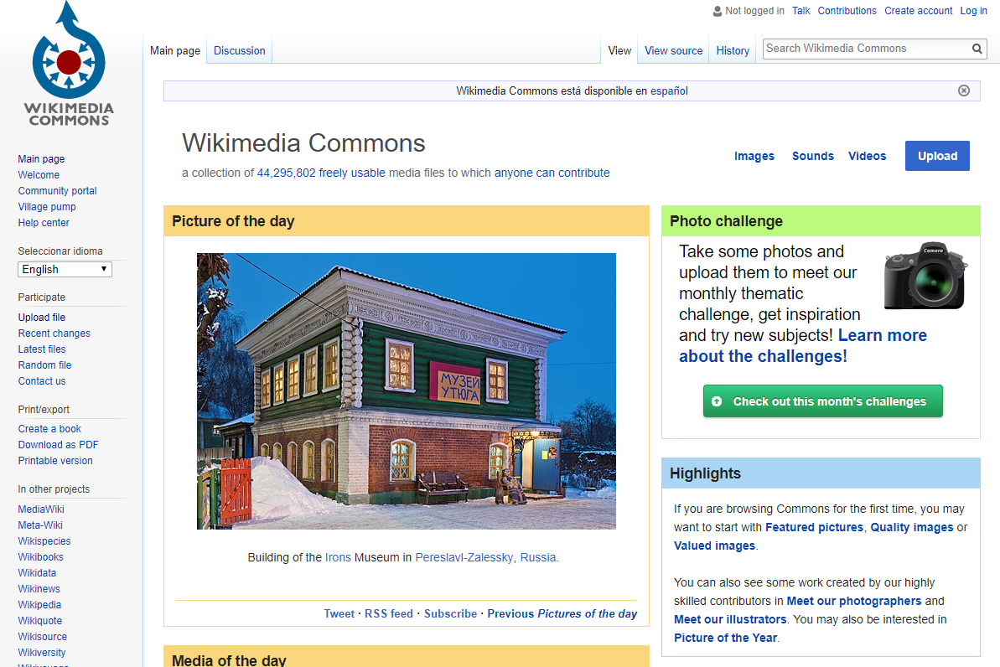

Slide 6
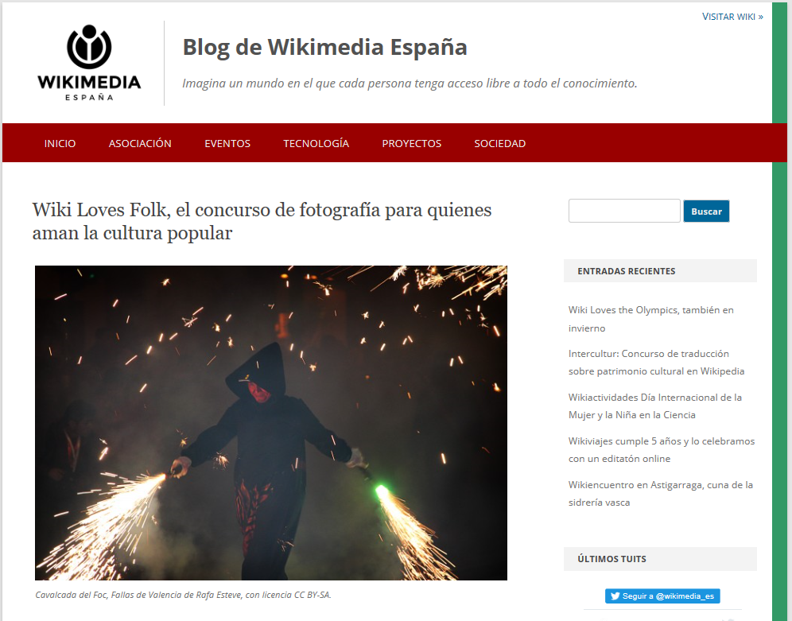

Slide 7
https://commons.wikimedia.org/wiki/Commons:Wiki_Loves_Folk/2017/Stats

Slide 8
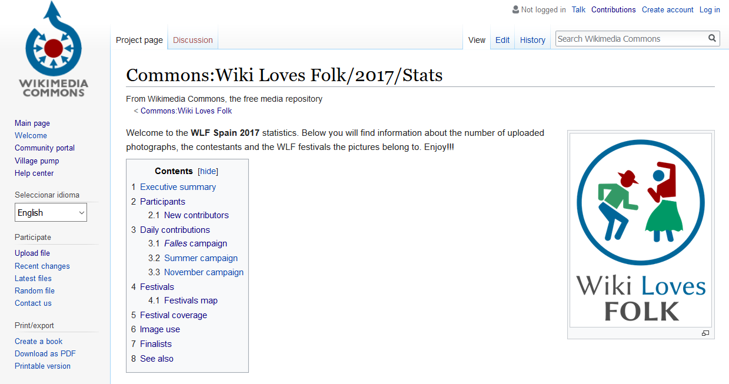

Slide 9
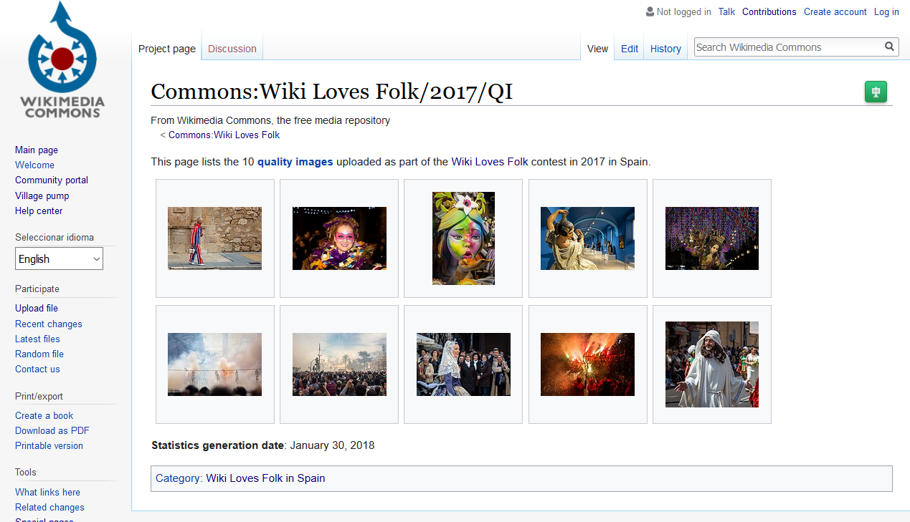

Slide 10
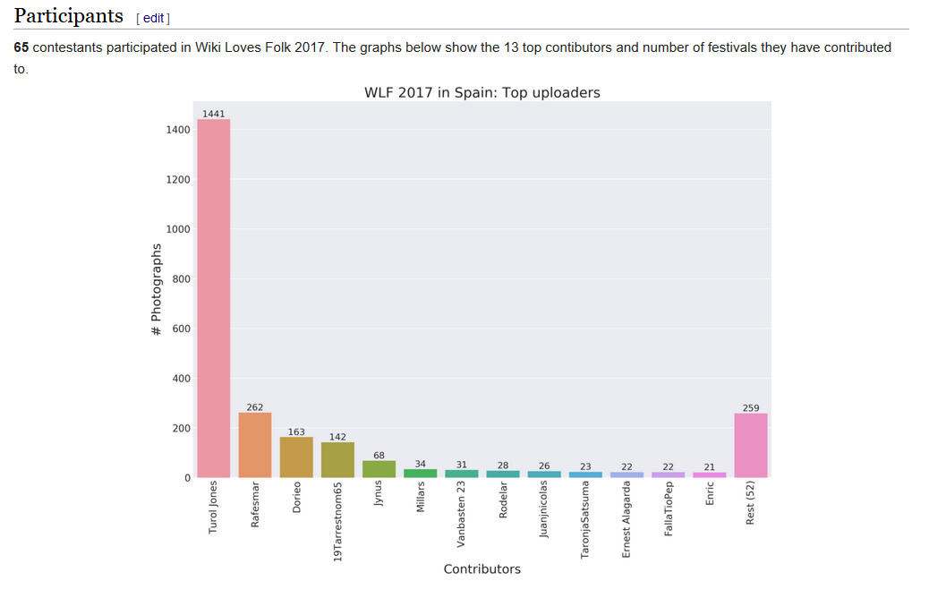

Slide 11
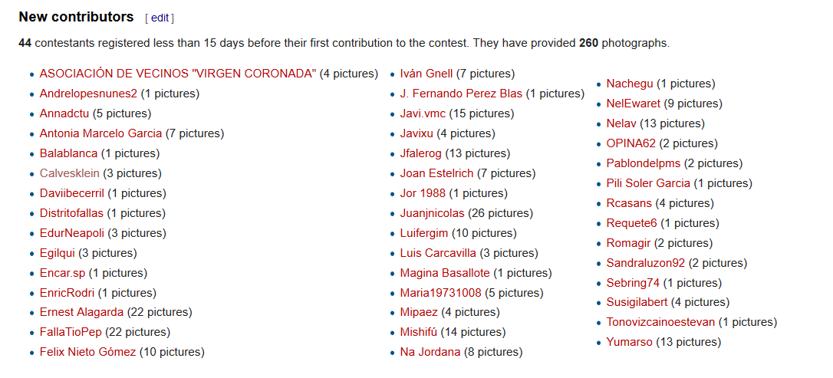

Slide 12
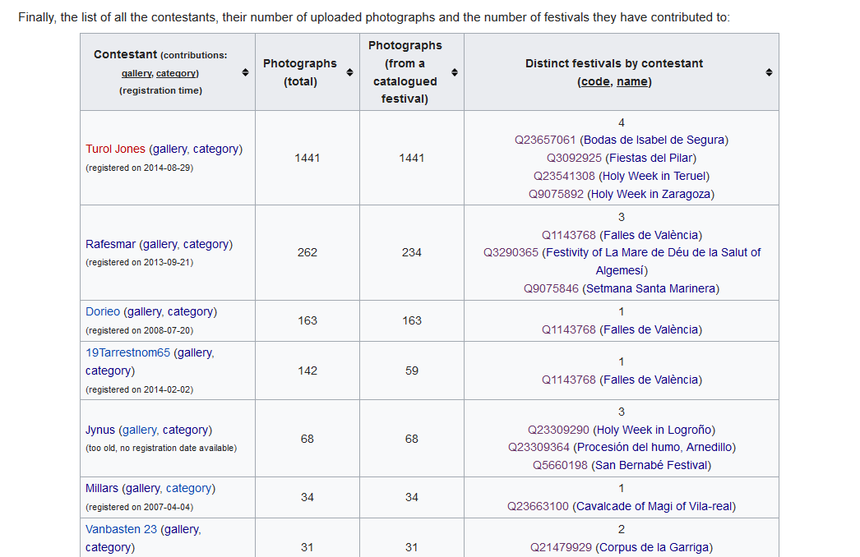

Slide 13
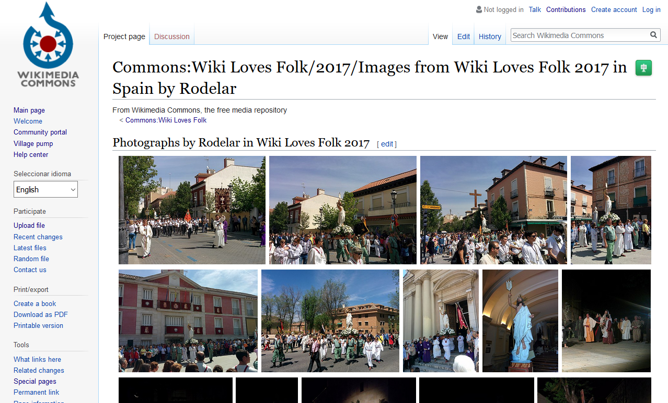

Slide 14
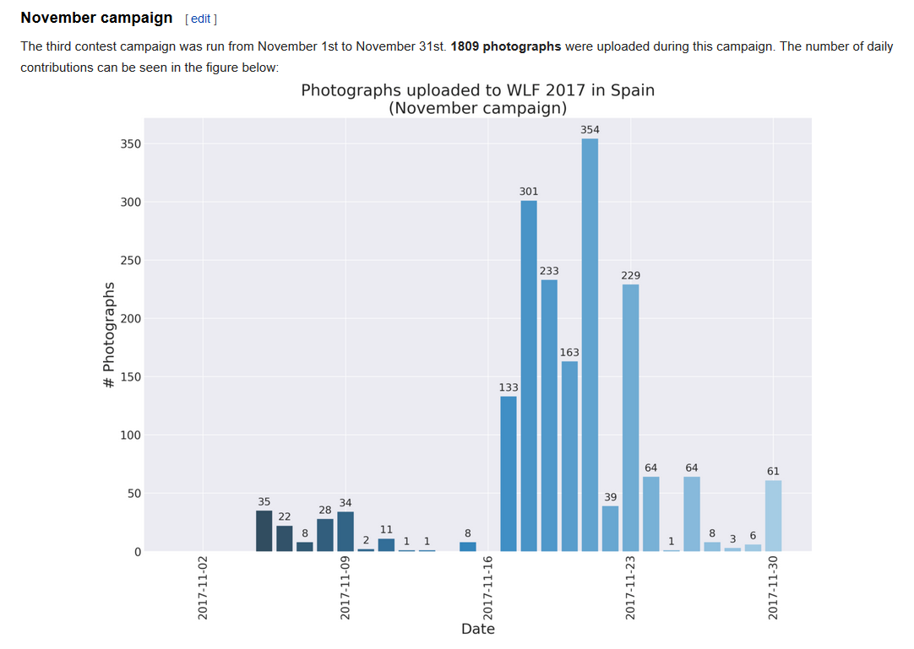

Slide 15
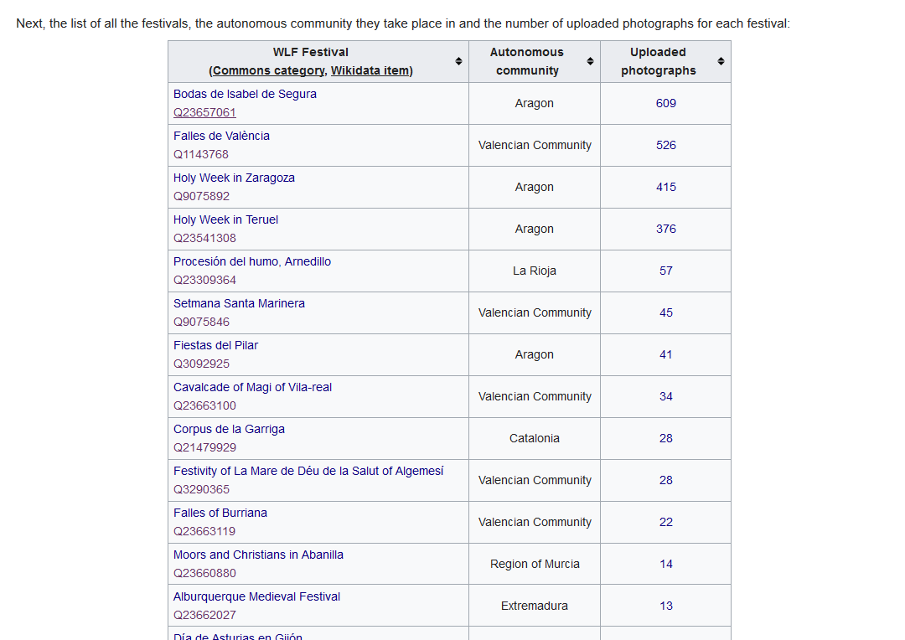

Slide 16
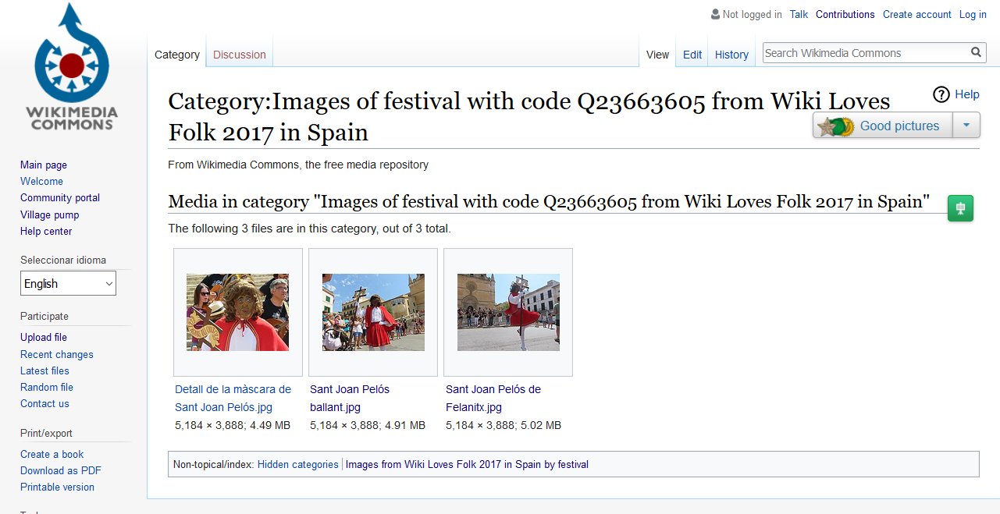

Slide 17
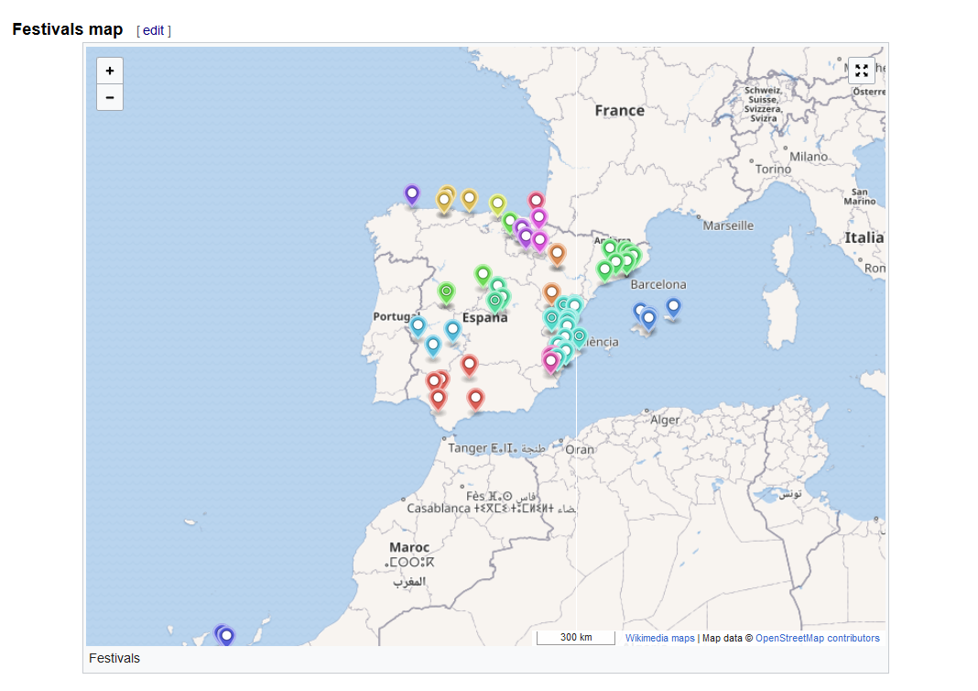

Slide 18
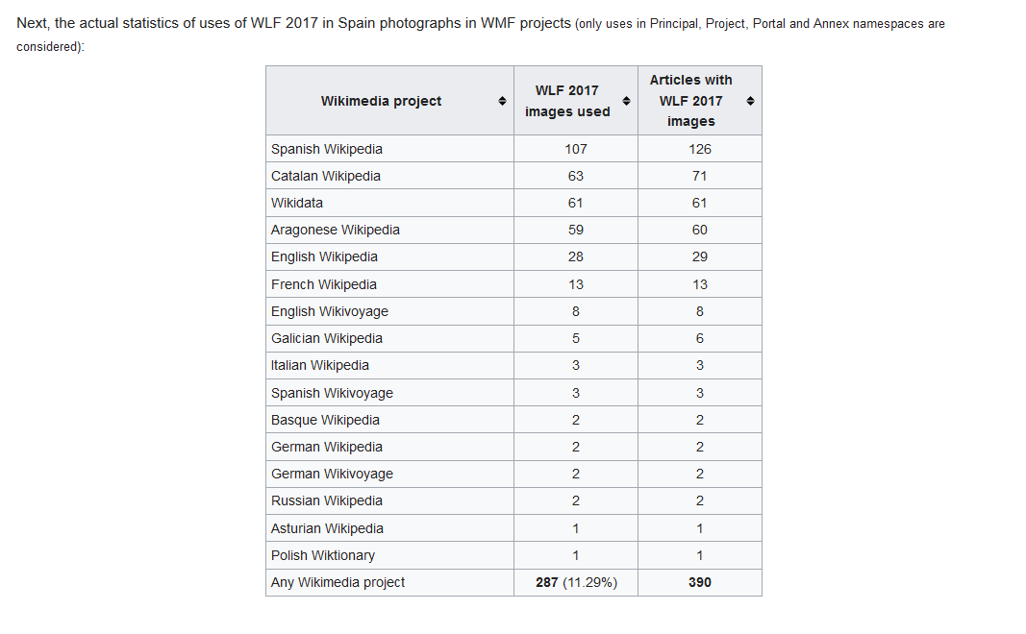

Slide 19
Bots? Automated edition in Wikipedia

Slide 20
A definition
A bot is a software application that performs automated tasks. Typically, bots perform tasks that are both simple and structurally repetitive, at a much higher rate than would be possible for a human alone.
In the Wikimedia projects, a bot is a software application that modifies any element of the project, either by uploading pictures, updating a page…

Slide 21
Bot frameworks
https://www.mediawiki.org/wiki/Help:Bots
https://www.mediawiki.org/wiki/API:Client_code

Slide 22
A Python bot framework: pywikibot Concepts and how-to

Slide 23
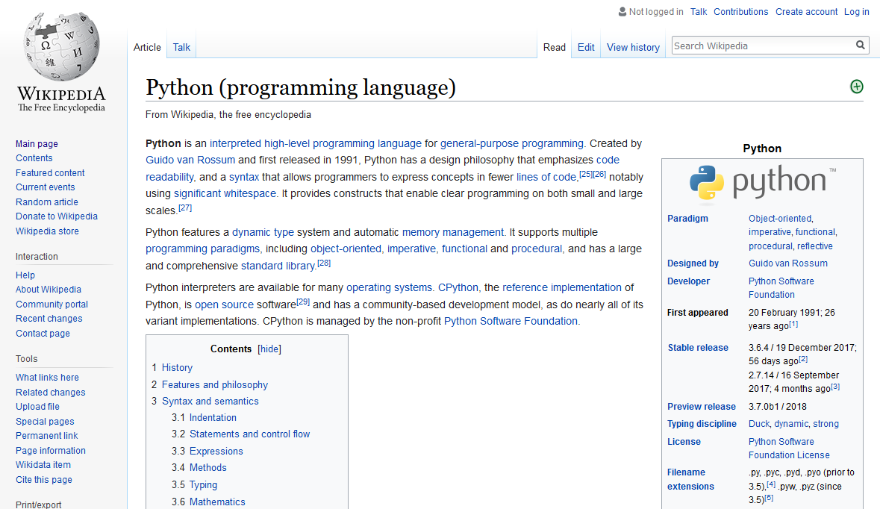

Slide 24
pywikibot
Python library and collection of tools that automate work on MediaWiki sites.
https://www.mediawiki.org/wiki/Manual:Pywikibot
https://doc.wikimedia.org/pywikibot/api_ref/pywikibot.html

Slide 25
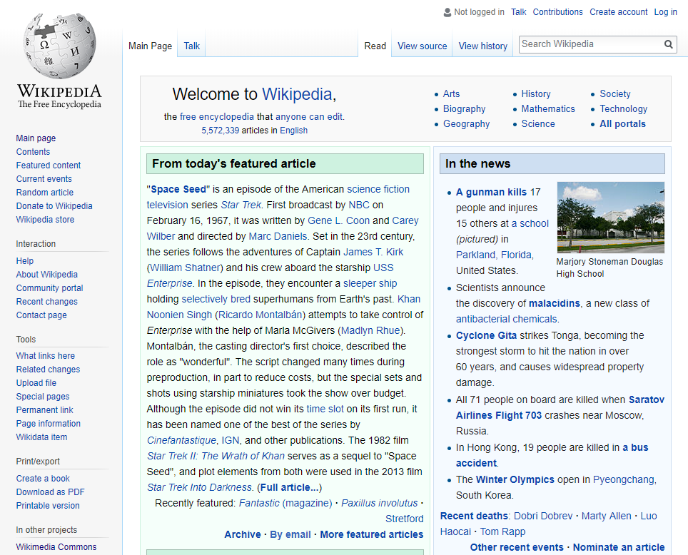
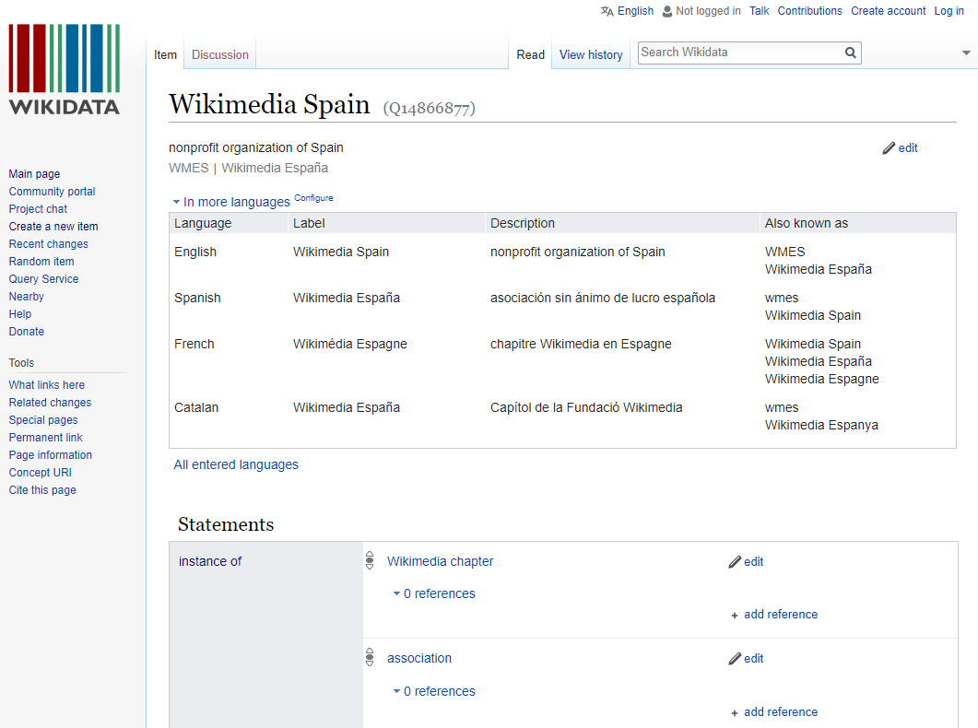
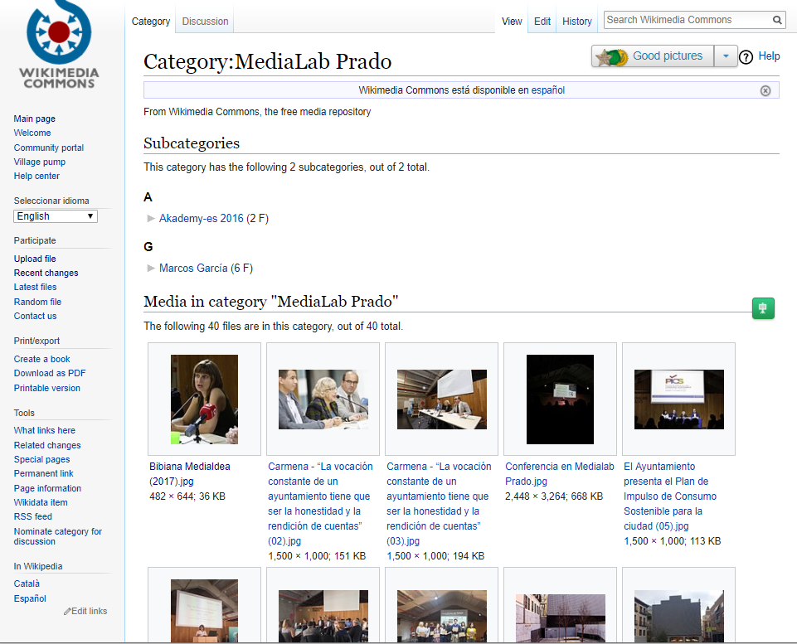
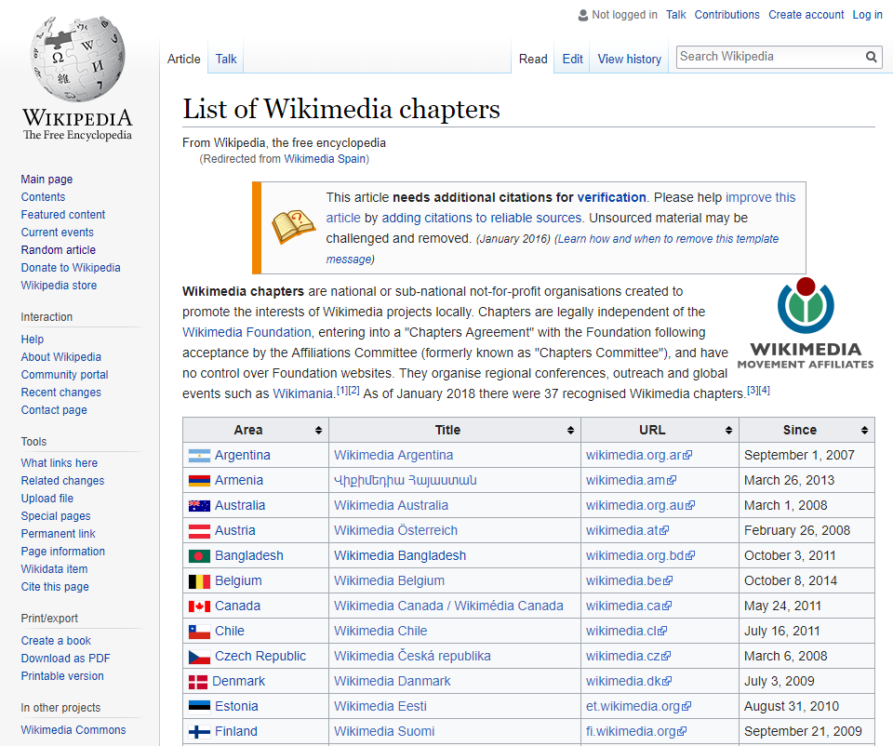
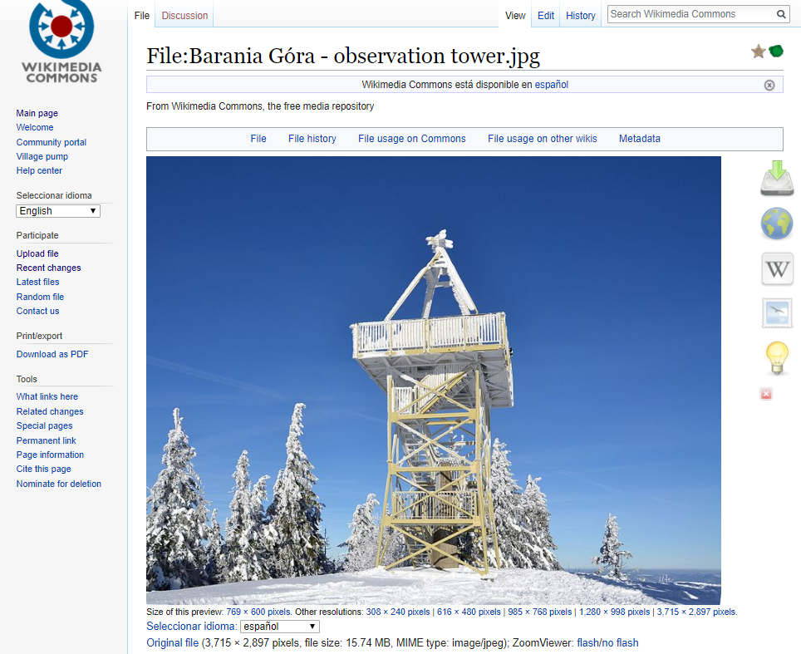
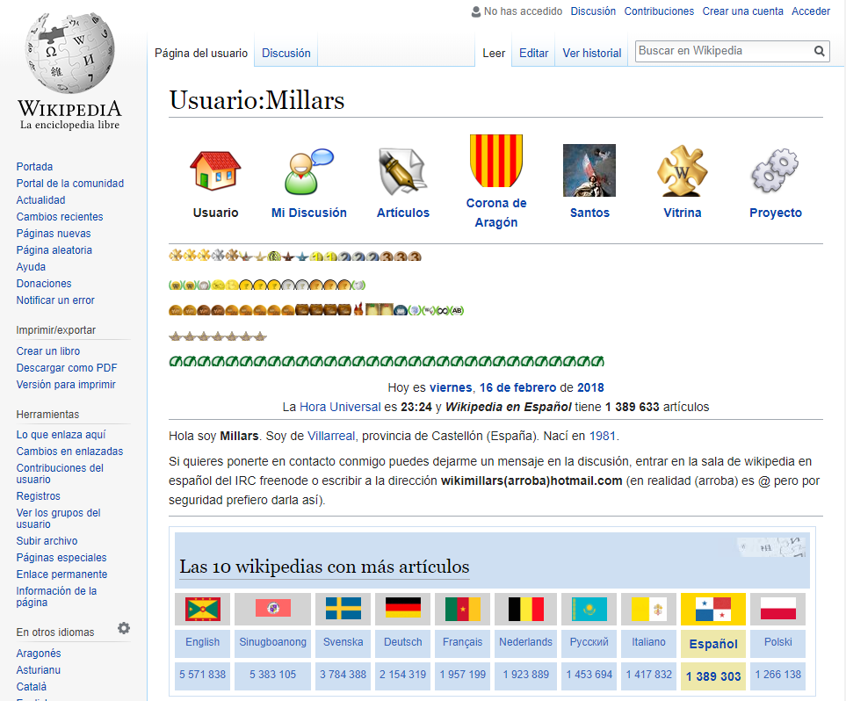
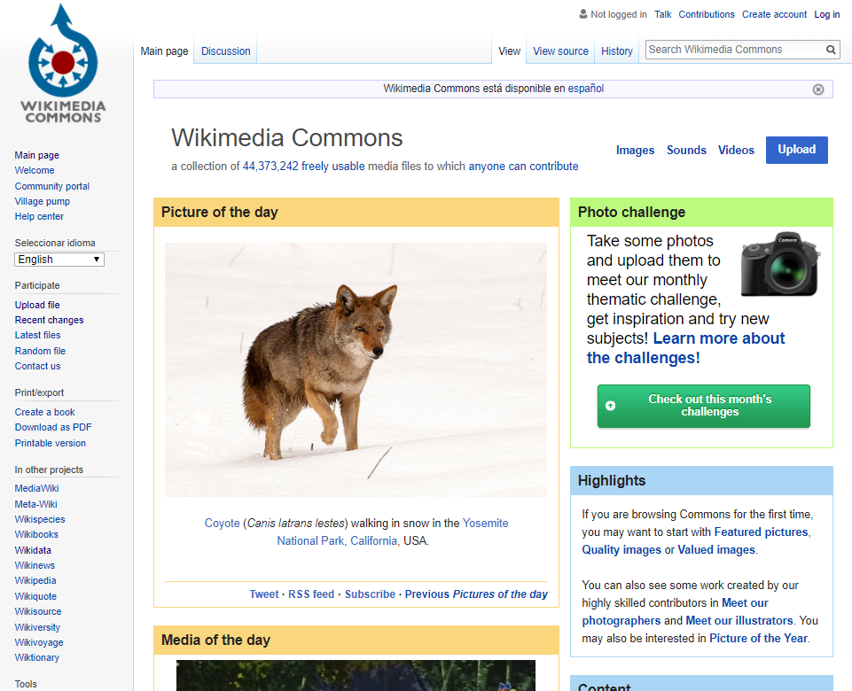
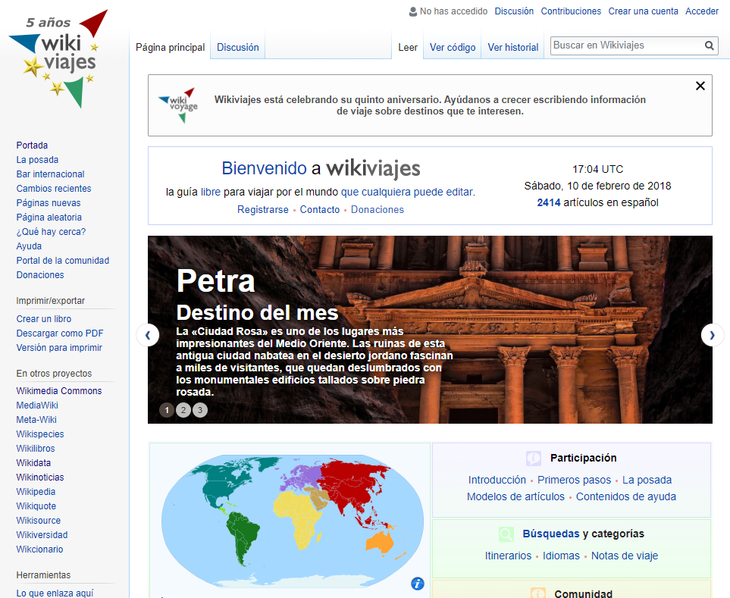
pywikibot: concepts
Site
Page
FilePage
ItemPage
Category
User
Represents a MediaWiki Project. Here, any project from the WMF.
Represents any MediaWiki page.
A subclass of Page representing a file description page.
A Wikidata item
A page in the Category: namespace.
A class that represents a Wiki user.

Slide 26
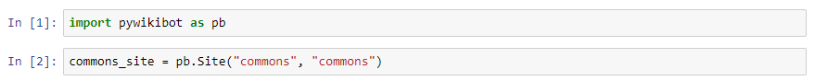
pywikibot: Site

Slide 27
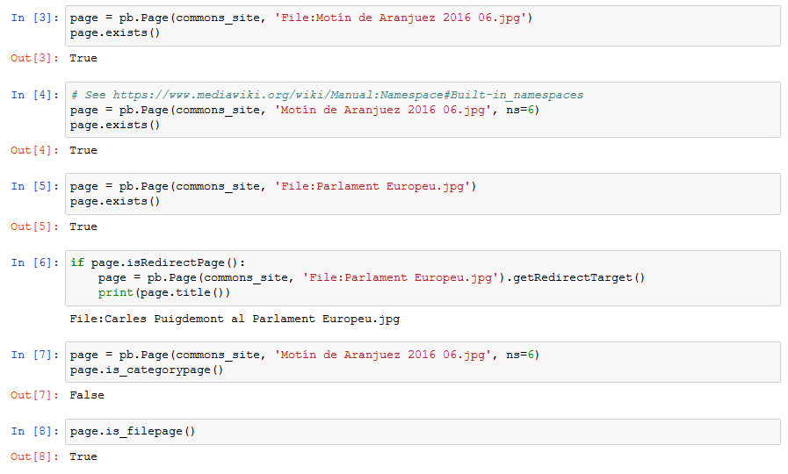
pywikibot: Page

Slide 28
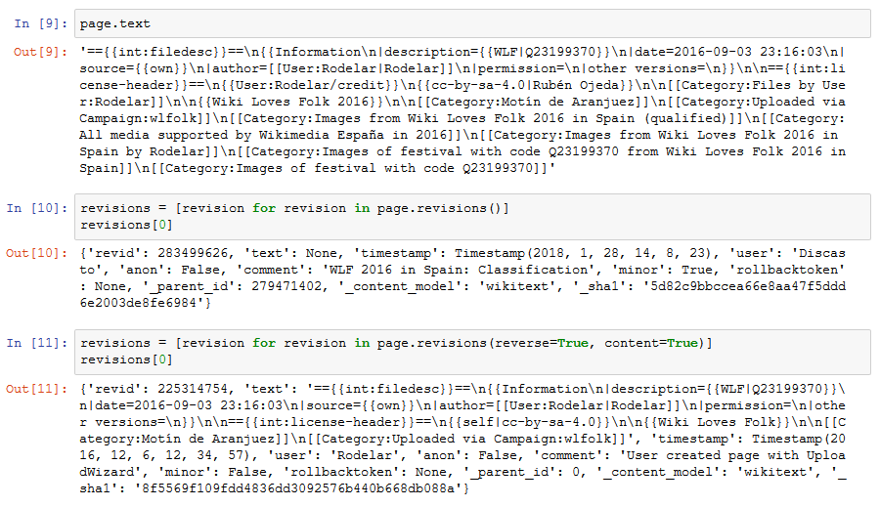

Slide 29
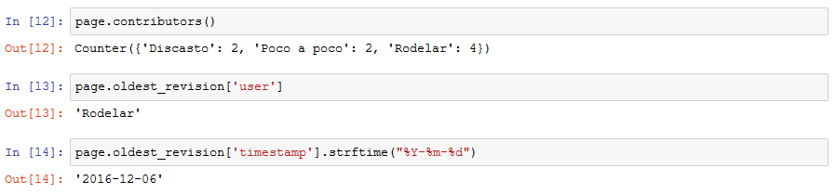

Slide 30
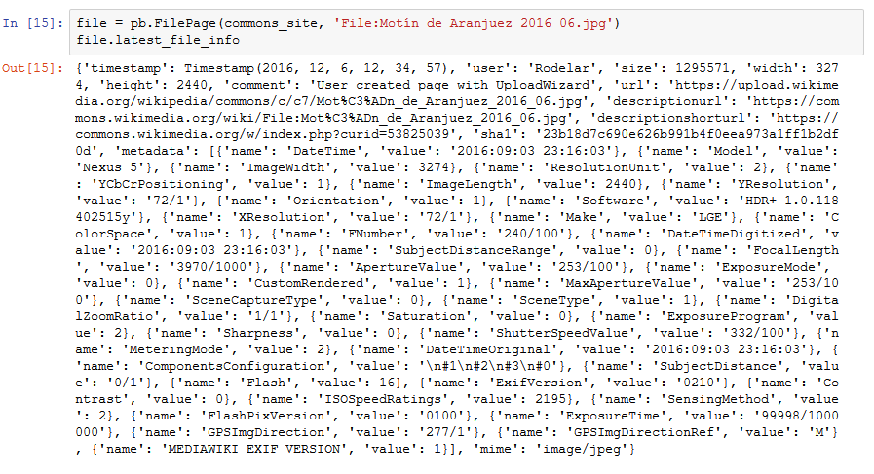
pywikibot: FilePage

Slide 31
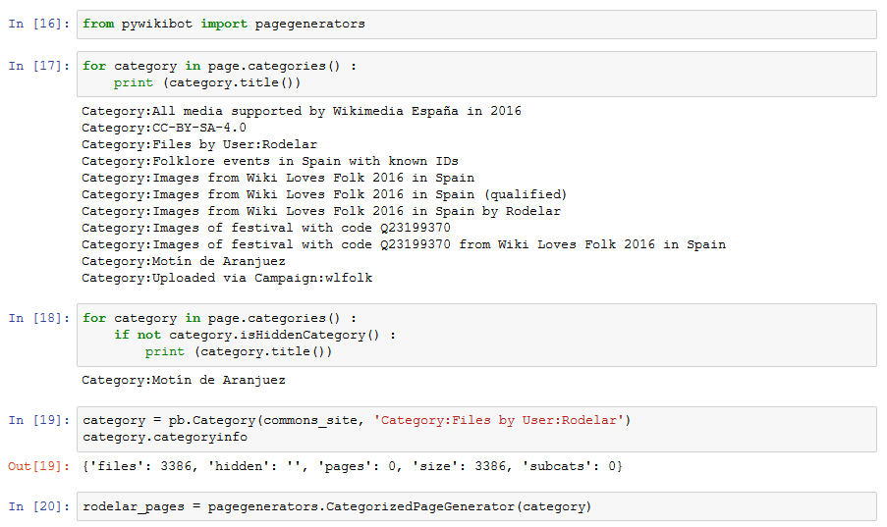
pywikibot: Category

Slide 32
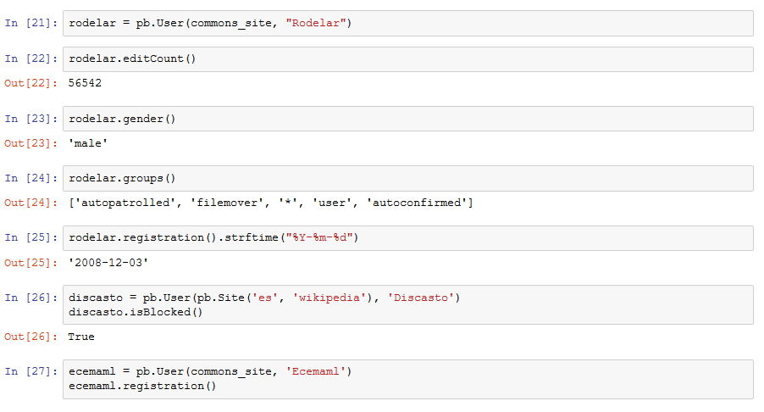
pywikibot: User

Slide 33
Python Nice Python packages to enhance your results

Slide 34
Python packages
pandas
Pillow
mwparserfromhell
matplotlib / seaborn
Mako
beautifulsoup4
geojson
http-request-randomizer

Slide 35
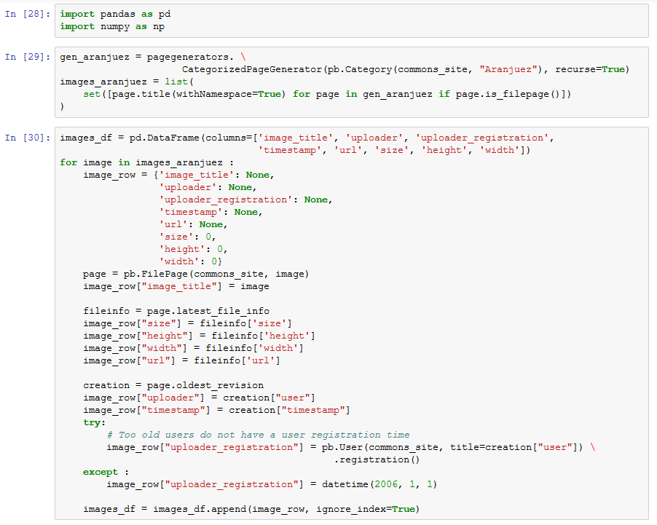
pandas

Slide 37
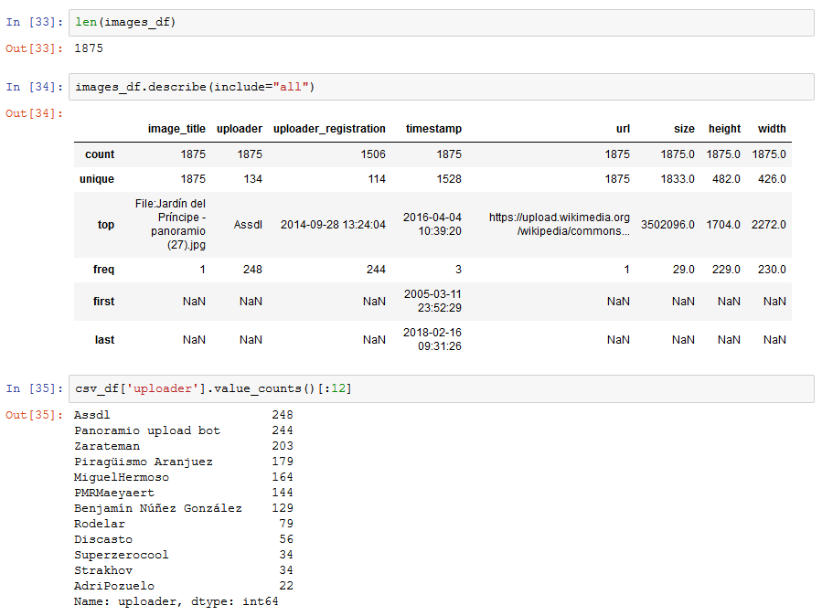

Slide 38
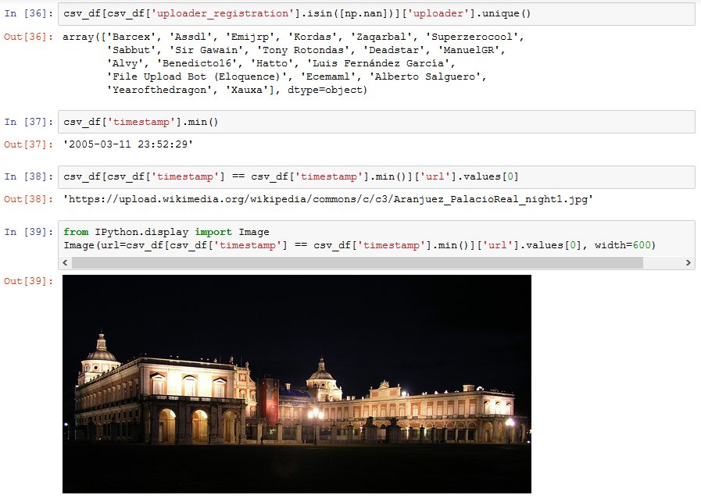

Slide 39
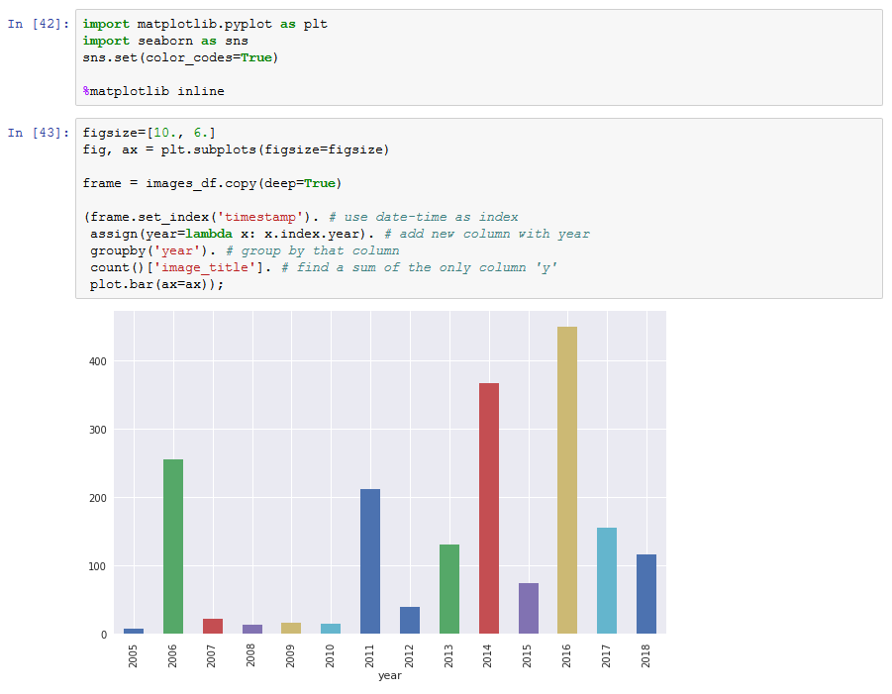
matplotlib seaborn

Slide 40
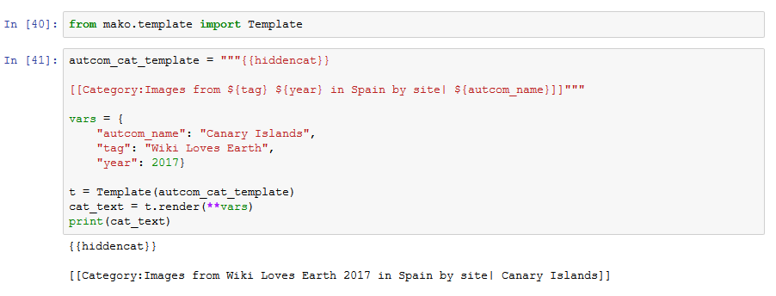
Mako

Slide 41
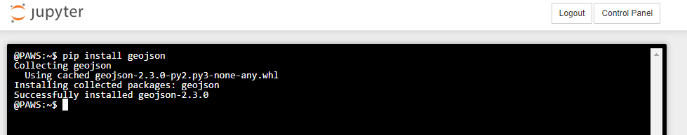
geojson

Slide 42
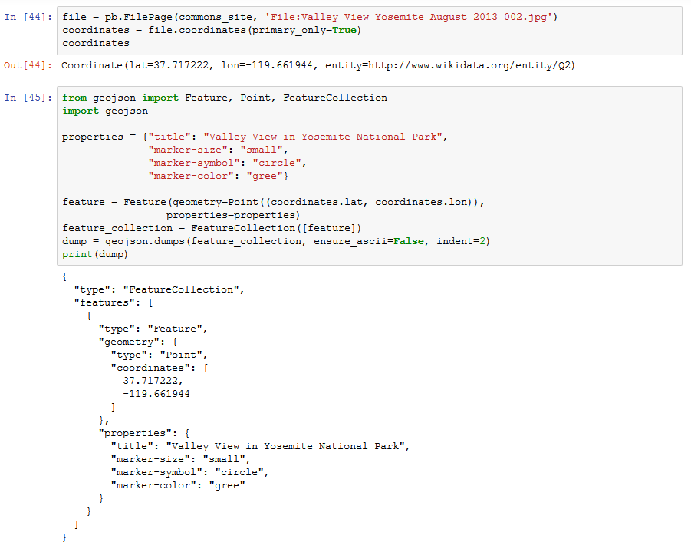

Slide 43
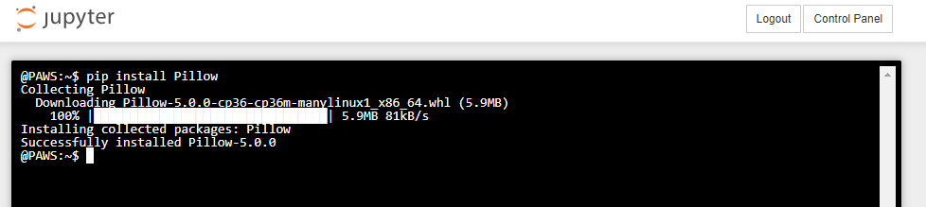
Pillow

Slide 44
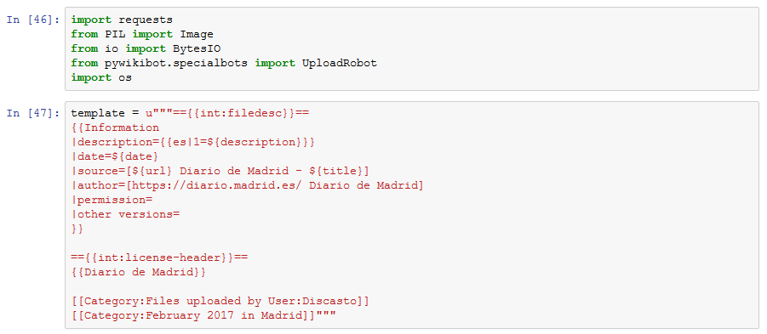

Slide 45
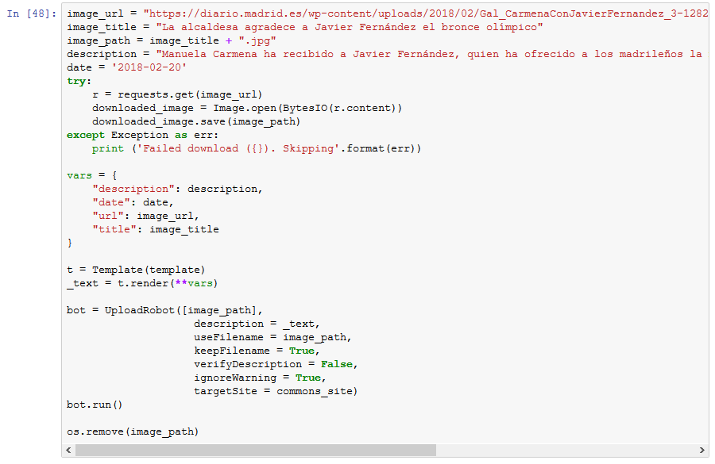

Slide 46
MediaWiki API Yet another way to interact with the projects

Slide 47
The MediaWiki API
The MediaWiki API is a web service that provides access to wiki features, data, and meta-data over HTTP, via a URL usually at api.php
https://www.mediawiki.org/wiki/API:Main_page
https://www.mediawiki.org/wiki/API:FAQ

Slide 48
URL elements
END POINT
https://commons.wikimedia.org/w/api.php ? action=query & format=json &
titles=File:Algemesí_MDS_-_Les_Pastoretes.jpg
prop=globalusage &
guprop=url|namespace &
gulimit=500
ACTION
FORMAT
QUERY-SPECIFIC PARAMETERS
METHOD: POST

Slide 49
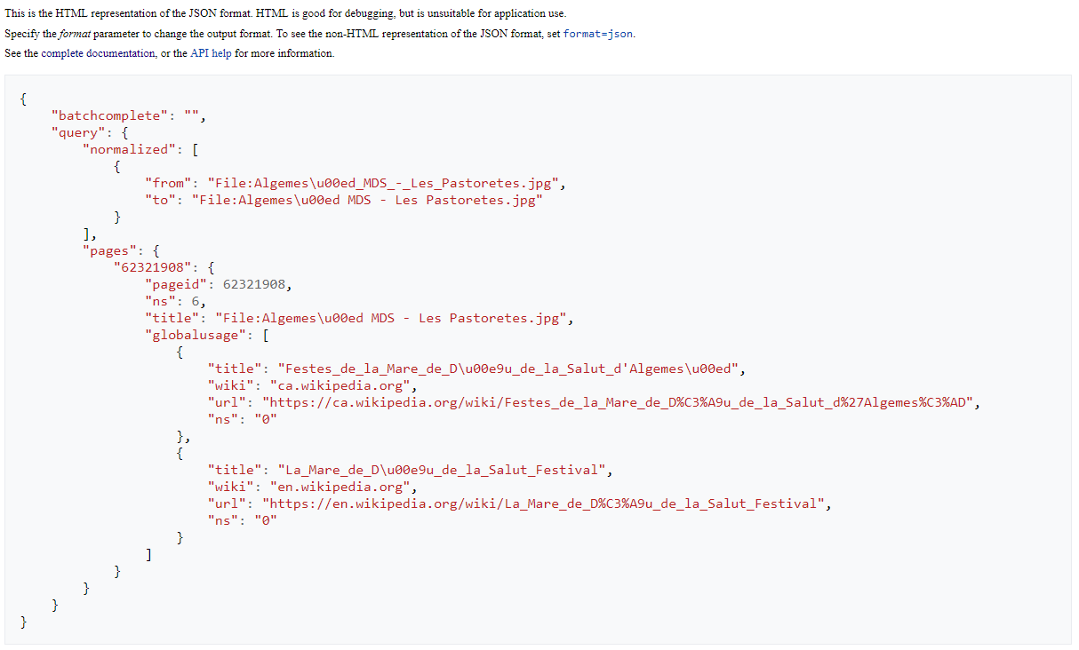
IMAGE ID
IMAGE TITLE
PAGE
PROJECT
NAME SPACE

Slide 50
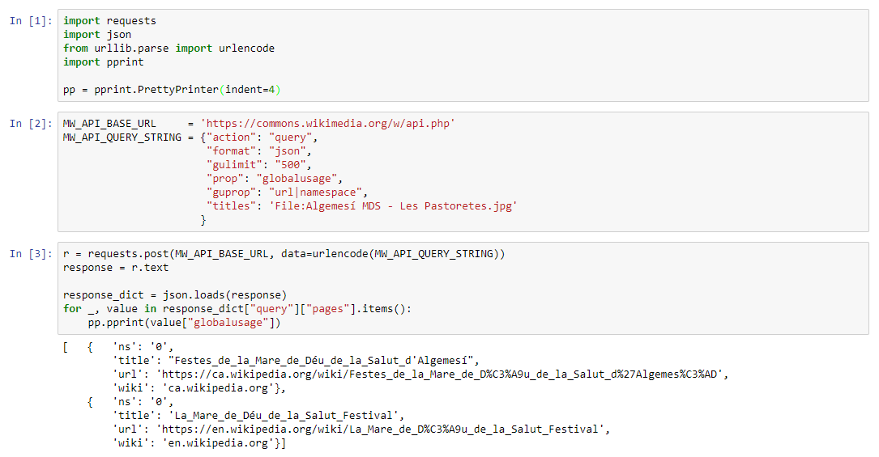

Slide 51
Extension:Kartographer Maps capabilities in Wikimedia projects

Slide 52
Extension: Kartographer
A MediaWiki extension that adds maps capabilities to Wikimedia projects
https://www.mediawiki.org/wiki/Help:Extension:Kartographer
Based on OpenStreetMap
Enabled by the <mapframe> tag within Wikimedia pages
Content must be valid GeoJSON (http://geojson.org/). Style with Maki Icons (https://www.mapbox.com/maki-icons/) is supported.

Slide 53
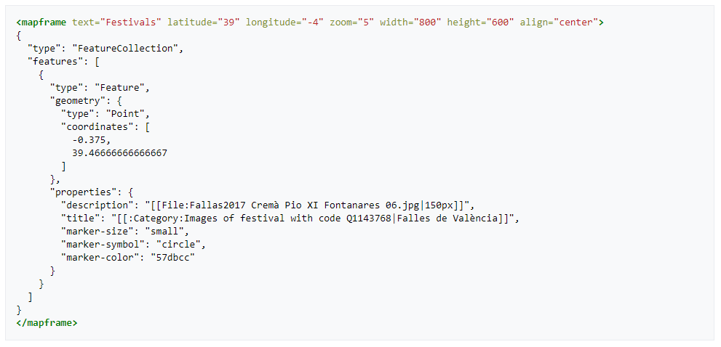
GeoJSON
MAP CENTER
FEATURE TYPE: POINT
MAP SIZE
TAG
IMAGE
COORDINATES
LINK
MARKER

Slide 54
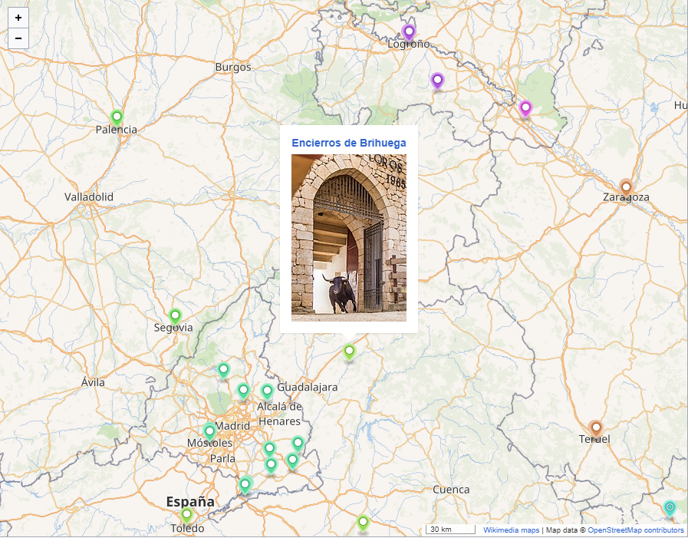
LINK
IMAGE
POINT

Slide 55
PAWS (Pywikibot: A Web Server) Local Pywikibot deployment not needed any more
Notes:
Let’s give them more power!

Slide 56
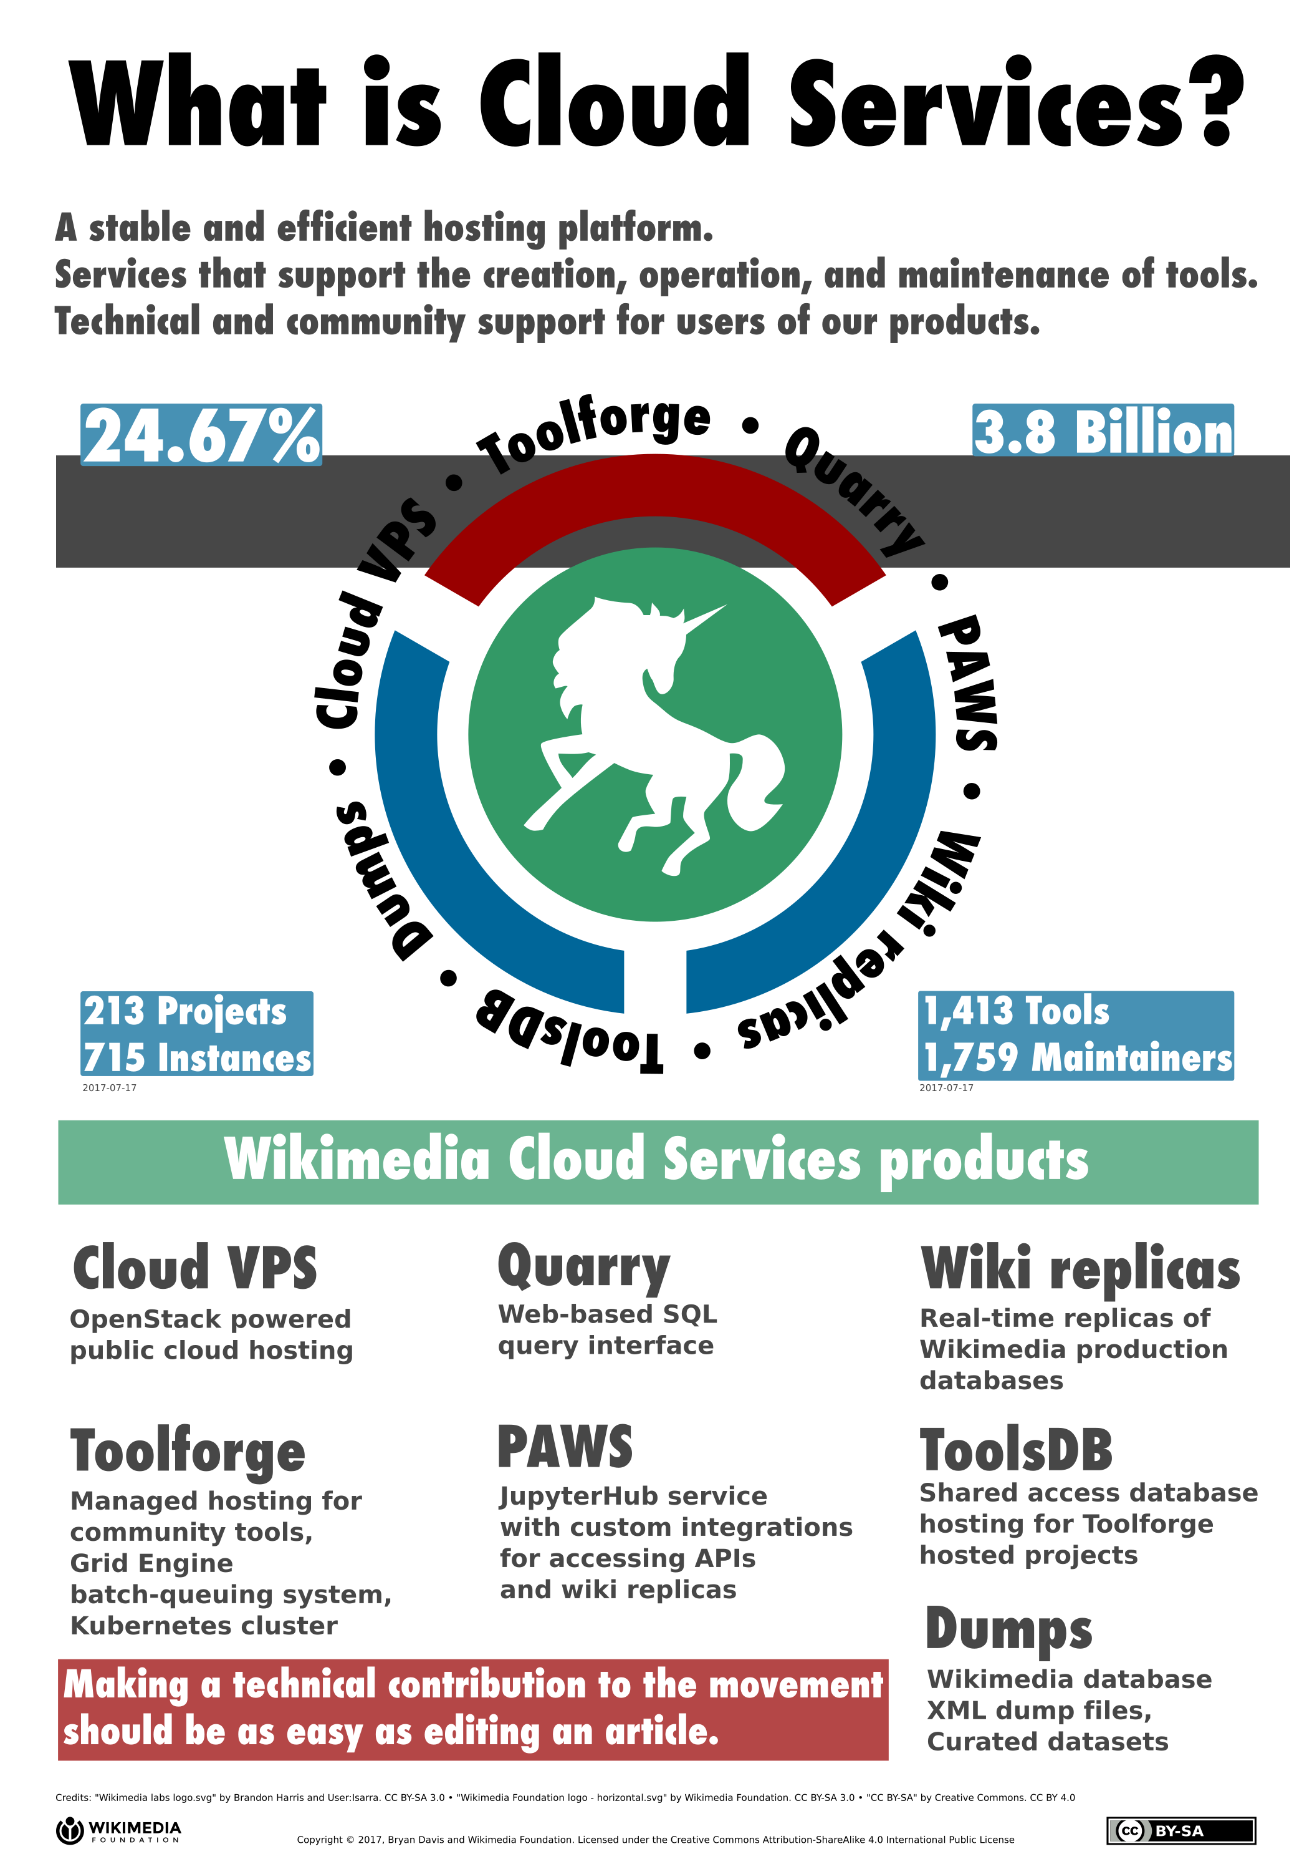
PAWS is a Jupyter Notebook Server provided by the Wikimedia Cloud Services: Python notebooks but also R and terminals.
Pre-integrated with Pywikibot and many other Python packages
pip, Git available…
Authenticated (through OAuth) with your Wikimedia account.
https://paws.wmflabs.org
http://paws-public.wmflabs.org/paws-public/User:YOURUSERNAME/
Notes:
Service https://paws.wmflabs.org Notebook public access http://paws-public.wmflabs.org/paws-public/User:YOURUSERNAME/YOURNOTEBOOK.ipynb Download a raw notebook file http://paws-public.wmflabs.org/paws-public/User:YOURUSERNAME/YOURNOTEBOOK.ipynb?format=raw

Slide 57
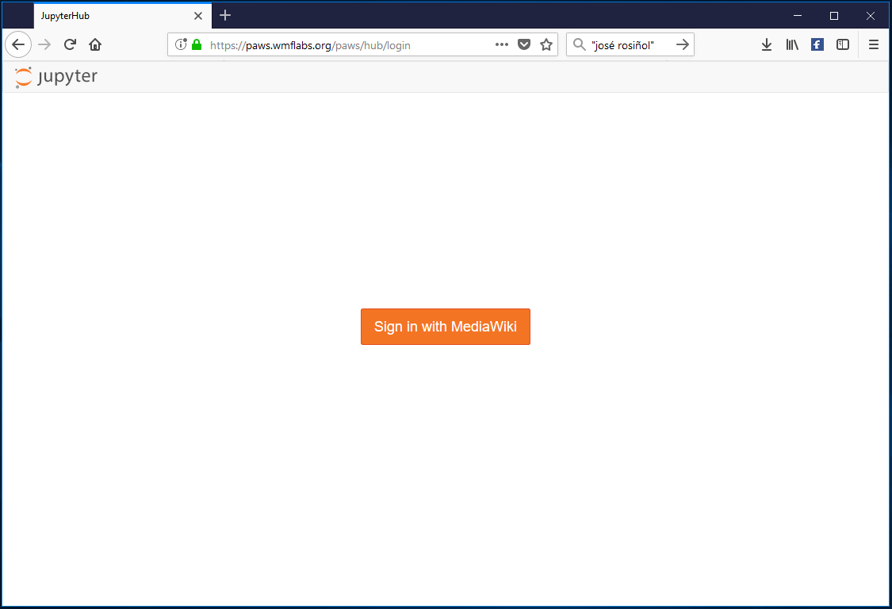

Slide 58
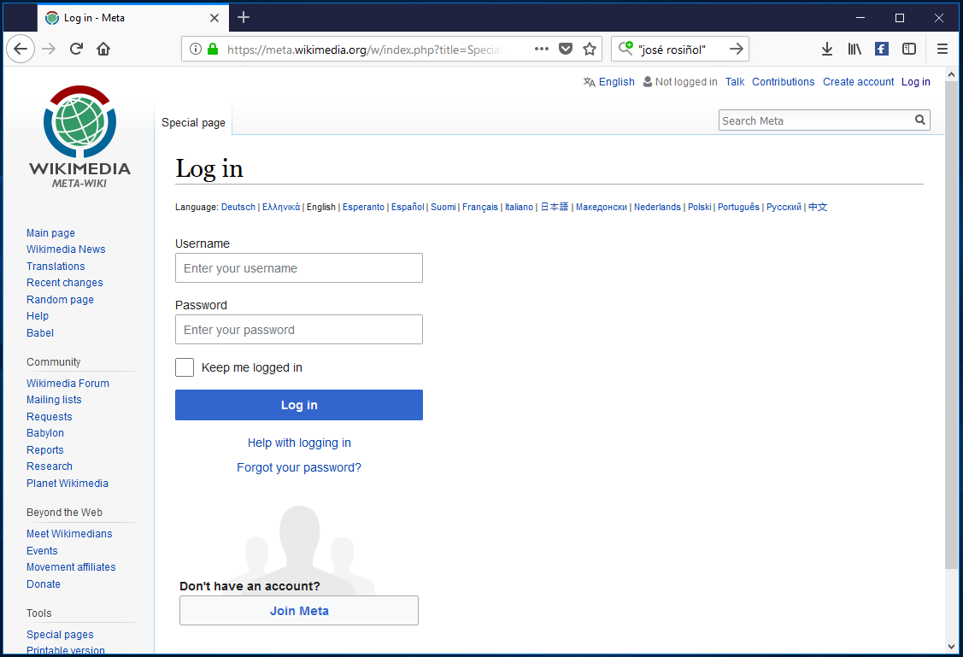

Slide 59
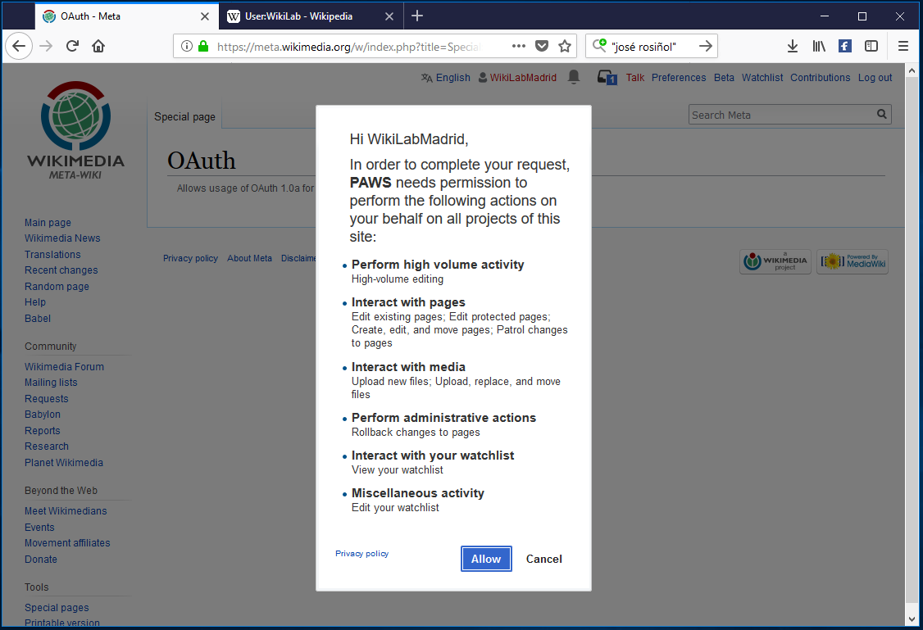

Slide 60
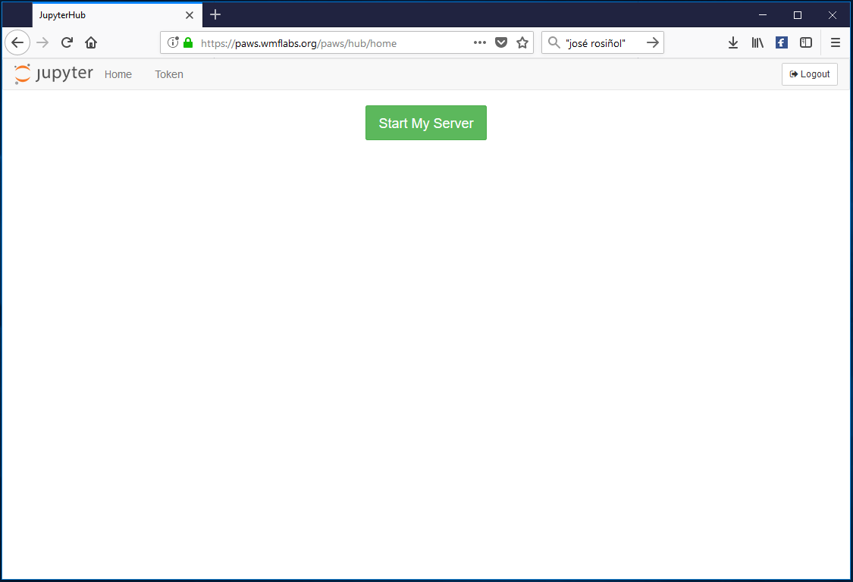

Slide 61
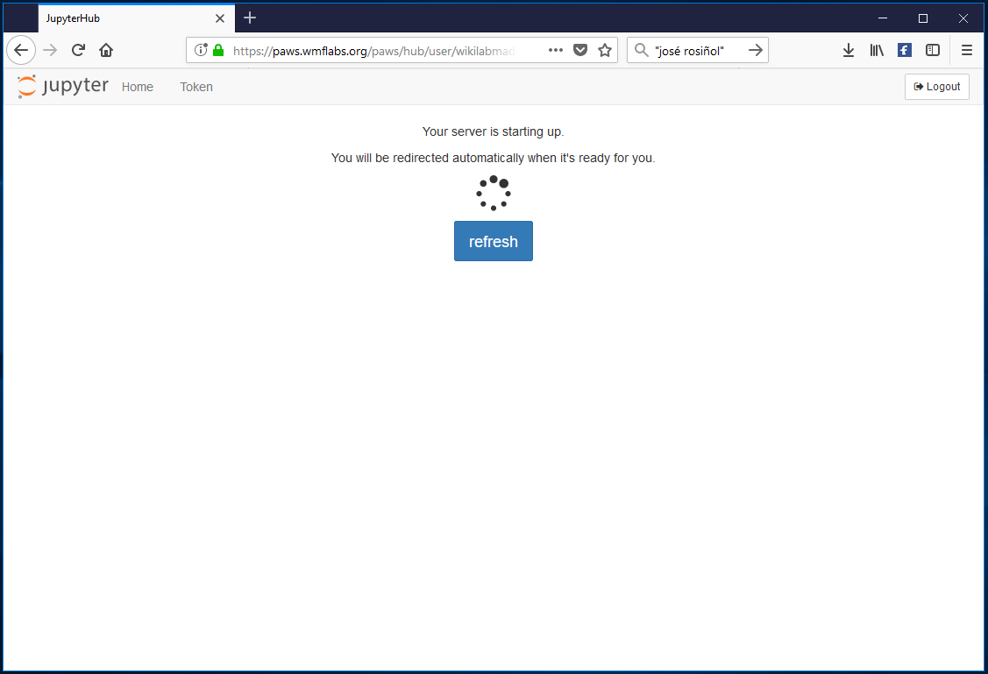

Slide 62


Slide 63


Slide 64


Slide 65

Your entire home directory (minus some special considerations for secret credential files) is public by default

Slide 66
Demo time Hands on: Wiki Loves Earth statistics

Slide 67


Inputs

Slide 68
Workflow
Create site log from annexes
Review, clean, and categorize images in Wiki Loves category
Create image log
Do the magic

Slide 69



Attribution-ShareAlike 3.0 Spain (CC BY-SA 3.0 ES)
Except where otherwise noted, this work by Miguel-Angel Monjas is licensed under
https://creativecommons.org/licenses/by-sa/3.0/es/

Slide 70
Thank you!
mmonjas@gmail.com
Thanks to Rubén Ojeda, Santi Navarro and Diego Delso for their support & encouragement!
Thanks to WM-ES and all the Wiki Loves team for their enthusiasm

